Slide 1
2. Sequence alignment
Theory and Practice of Bioinformatics
Jia-Ming Chang, CS.NCCU
The slide is only for educational purposes. If any infringement, please contact me. We will correct immediately.

Slide 2
References
Slides are mainly based on
B&FG 3e
Bioinformatics and Functional Genomics 3rd Edition by Jonathan Pevsner
http://www.bioinfbook.org/php/powerpoints
Adapted from Cedric Notredame
Principal Investigator, Centre For Genomic Regulation, Barcelona
http://www.tcoffee.org/Courses/Exercises/index.html

Slide 3
NIPS Keynote speaker: AI重新編寫人類基因組以改善疾病 by Brendan Frey
Reprogramming the Human Genome With Artificial Intelligence - Brendan Frey - NIPS 2017
https://www.youtube.com/watch?v=QJLQBSQJEus
https://datahub.packtpub.com/machine-learning/nips-2017-special-machine-learning-genomics-bridging-gap-research-clinical-trial-success-brendan-frey/

Slide 4
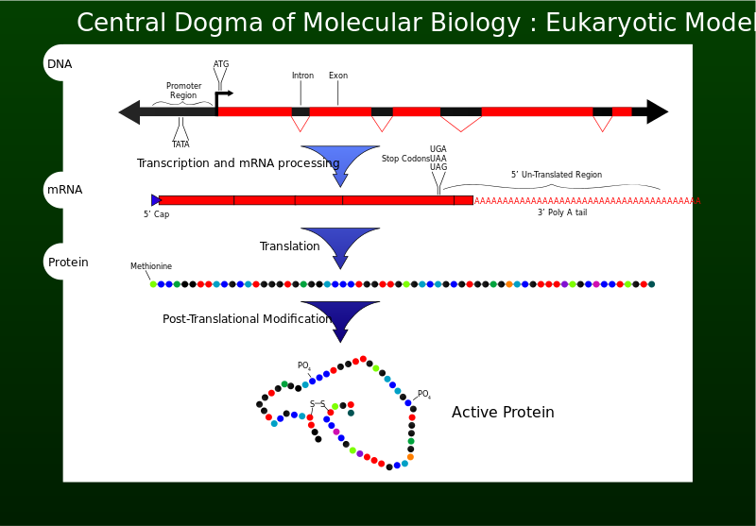
Course Description
Crick, Francis (1970). Central dogma of molecular biology. Nature 227 (5258): 561–3.
Figs from Overview of the central dogma of molecular biology. Original work by Mike Jones for wikipedia

Slide 5
Why Do We Need Sequence Alignment ? Its application in structure homology and evolutionary modeling context.

Slide 6
Manguel M, Samaniego F.J., Abraham Wald’s Work on Aircraft Suvivability, J. American Statistical Association. 79, 259-270, (1984)
Adapted from Cedric Notredame

Slide 7
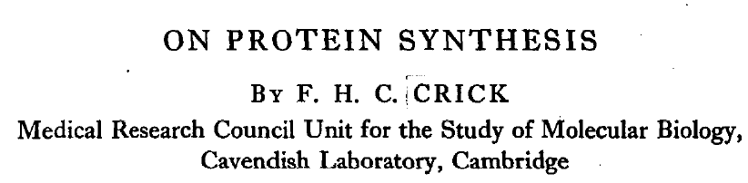
Biologists should realise that before long we shall have a subject which might be called ‘protein taxonomy’—the study of the amino acid sequences of the proteins of an organism and the comparison of them between species. It can be argued that these sequences are the most delicate expression possible of the phenotype of an organism and that vast amounts of evolutionary information may be hidden away within them.
Crick FHC. On protein synthesis. Symp Soc Exp Biol. 1958; 12:138–163. PMID: 13580867

Slide 8

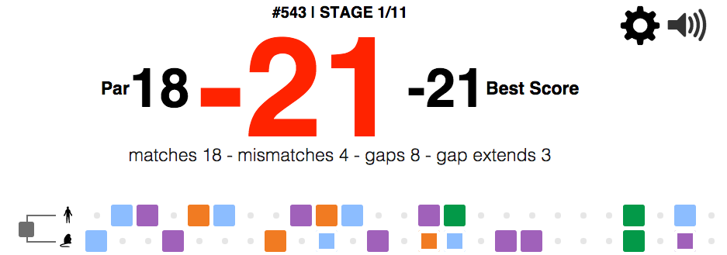
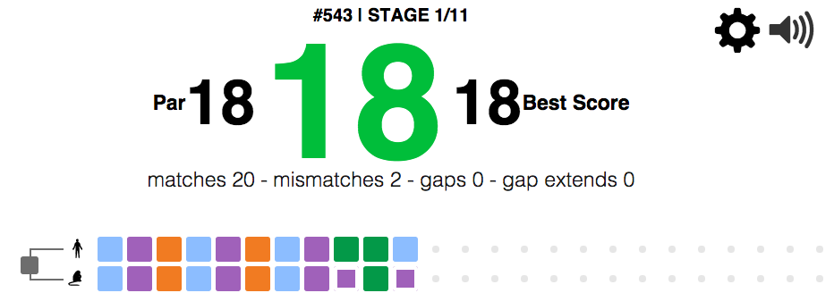
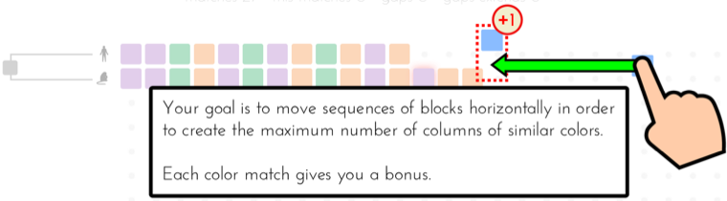
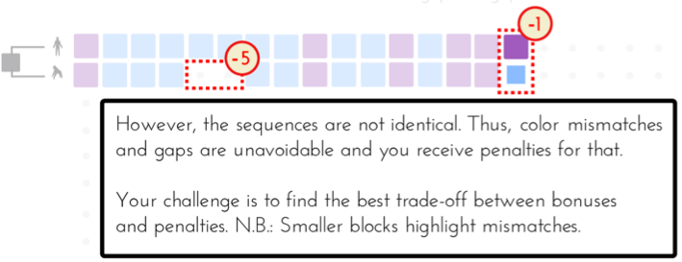
Sequence alignment
http://phylo.cs.mcgill.ca/

Slide 9
Why Does It Make Sense To Align Sequences ?
Evolution is our Real Tool.
Nature is LAZY and Keeps re-using Stuff.
Evolution is mostly DIVERGEANT
Same Sequence ⬄ Same Ancestor
Adapted from Cedric Notredame

Slide 10

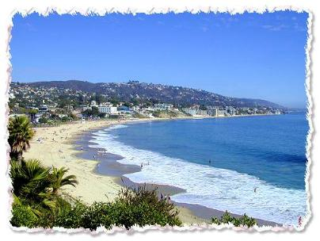
An Alignment is a STORY
ADKPKRPLSAYMLWLN
ADKPKRPLSAYMLWLN
ADKPKRPLSAYMLWLN
Mutations
+
Selection
ADKPRRPLS-YMLWLN
ADKPKRPKPRLSAYMLWLN
Insertion
Deletion
ADKPRRP---LS-YMLWLN
ADKPKRPKPRLSAYMLWLN
Mutation
Adapted from Cedric Notredame
Notes:
Mutations, deletions are the engines of evolution, but selection does the steering…
As shown here it is often impossible to tell appart insertions and deletions, hence their generic name: indels.
Next: Homology

Slide 11
Pairwise sequence alignment is the most fundamental operation of bioinformatics
It is used to decide if two proteins (or genes) are related structurally or functionally
It is used to identify domains or motifs that are shared between proteins
It is the basis of BLAST searching
It is used in the analysis of genomes
B&FG 3e Page 69

Slide 12
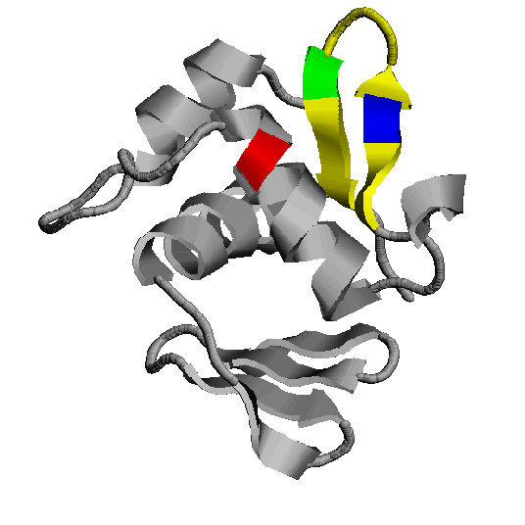
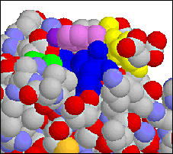
How Do Sequences Evolve ?
In a structure, each Amino Acid plays a Special Role
+
On the surface, CHARGE MATTERS
-
-
In the core, SIZE MATTERS
OmpR, Cter Domain
Adapted from Cedric Notredame

Slide 13
How Do Sequences Evolve ?
Accepted Mutations Depend on the Structure
Charged -> Non Charged
Big -> Big
Small -> Big
DELETIONS
-
+
DELETIONS
-
Charged -> Non Charged
Small <-> Big or Small
Adapted from Cedric Notredame

Slide 14
Sequence alignment: protein sequences can be more informative than DNA
protein is more informative (20 vs 4 characters)
many amino acids share related biophysical properties
codons are degenerate
changes in the third position often do not alter the amino acid that is specified
protein sequences offer a longer “look-back” time
searching for plant globins using human beta globin DNA yields no matches
searching for plant globins using human beta globin => protein yields many matches
B&FG 3e
Page 70

Slide 15
Pairwise alignment: DNA sequences can be more informative than protein
Many times, DNA alignments are appropriate
study noncoding regions of DNA
introns or intergenic regions
study DNA polymorphisms
genome sequencing relies on DNA analysis
B&FG 3e
Page 70

Slide 16
Pairwise alignment

Slide 17
Pairwise alignment
The process of lining up two sequences to achieve maximal levels of identity (and conservation, in the case of amino acid sequences) for the purpose of assessing the degree of similarity and the possibility of homology.
B&FG 3e Page 70

Slide 18
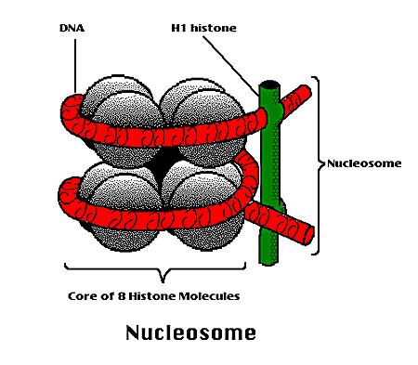
How Can We Compare Sequences ?
To Compare Two Sequences, We need:
Their Structure
Their Function
We Do Not Have Them !!!
Adapted from Cedric Notredame

Slide 19
General approach to pairwise alignment
Choose two sequences
Select an algorithm that generates a score
Allow gaps (insertions, deletions)
Score reflects degree of similarity
Alignments can be global or local
Estimate probability that the alignment occurred by chance
B&FG 3e

Slide 20
Measures of the distance
Hamming distance
agtc
cgta
Edit distance (Levenshtein)
ag-tcc
cgctca

Slide 21
Substitution Matrix

Slide 22
How Can We Compare Sequences ?
To Compare Sequences, We need to Compare Residues
We Need to Know How Much it COSTS to SUBSTITUTE
an Alanine into an Isoleucine
a Tryptophan into a Glycine
The table that contains the costs for all the possible substitutions is called the SUBSTITUTION MATRIX
Adapted from Cedric Notredame

Slide 23
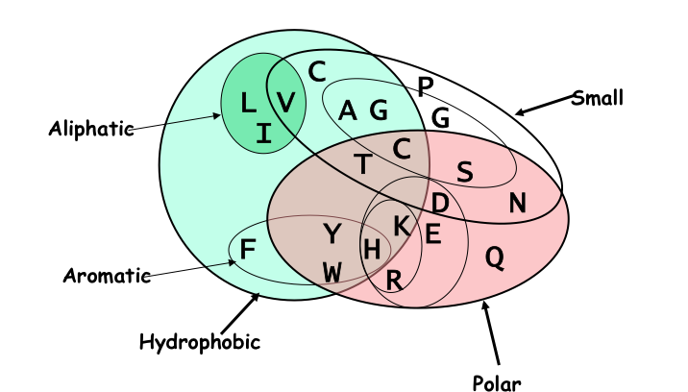
How Can We Compare Sequences ?
Using Knowledge Could Work
But we do not know enough about Evolution and Structure.
Using Data works better.
Adapted from Cedric Notredame

Slide 24
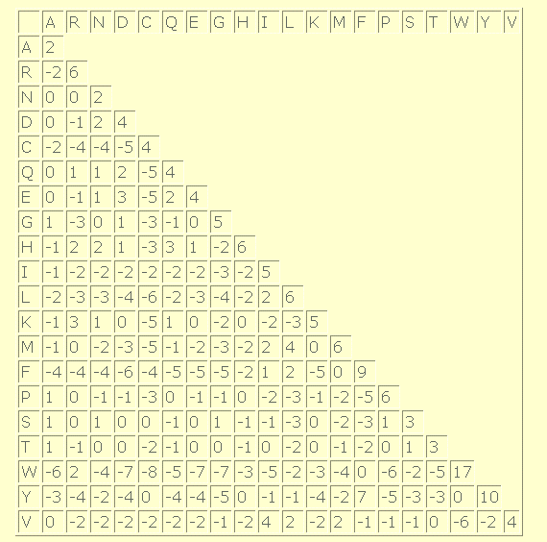
Making a Substitution Matrix
The Diagonal Indicates How Conserved a residue tends to be.
W is VERY Conserved
Some Residues are Easier To mutate into other similar.
Adapted from Cedric Notredame

Slide 25
How to derive that matrix?

Slide 26
Substitution Matrix
contains values proportional to the probability that amino acid i mutates into amino acid j for all pairs of amino acids.
constructed by assembling a large and diverse sample of verified pairwise alignments (or multiple sequence alignments) of amino acids.
should reflect the true probabilities of mutations occurring through a period of evolution.
The two major types of substitution matrices
PAM
BLOSUM
B&FG 3e

Slide 27
Making a Substitution Matrix
Take 100 nice pairs of Protein Sequences, easy to align (80% identical).
Align them…
Count each mutations in the alignments
25 Tryptophans into phenylalanine
30 Isoleucine into Leucine
….
…
Adapted from Cedric Notredame

Slide 28
Point Accepted Mutations/ Percent Accepted Mutation (PAMs)
Margaret Dayhoff and colleagues developed scoring matrices in the 1960s and 1970s.
Dayhoff, M.O., Schwartz, R. and Orcutt, B.C. (1978). "A model of Evolutionary Change in Proteins". Atlas of protein sequence and structure (volume 5, supplement 3 ed.). Nat. Biomed. Res. Found. pp. 345–358
A unit of evolutionary distance between 2 amino acid sequences.
1 PAM
1 accepted point-mutation (no insertions or deletions) event per 100 aa
Margaret Oakley Dayhoff, 1925~1983
Credit by https://commons.wikimedia.org/wiki/File:Margaret_Oakley_Dayhoff_cropped.jpg

Slide 29
Dayhoff’s protein superfamilies
Samples to sequences that are sufficiently similar, why?
No position has changed more than once
PAM matrices are based on global alignments of closely related proteins.
Examined 1572 changes in 71 groups of closely related proteins (>85% amino acid identity).
Adapted from Cedric Notredame

Slide 30
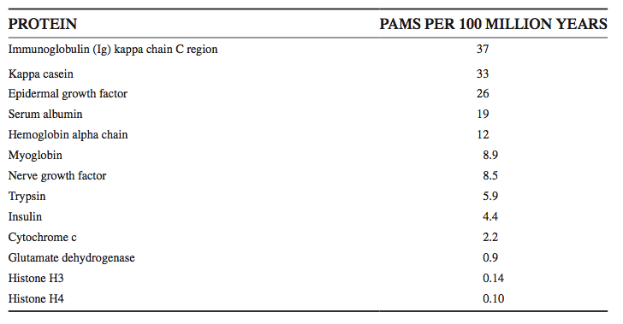
Some protein families evolve very slowly (e.g. histones change little over 100 million years); others change very rapidly
B&FG 3e, Box 3-4, Page 77

Slide 31
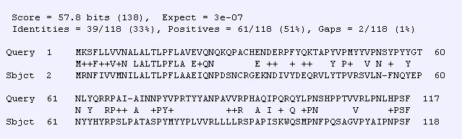
kappa casein change very rapidly
Protein PAMs per 100 million years
Kappa casein 33
human (NP_005203) versus mouse (NP_031812) kappa casein
B&FG 3e

Slide 32
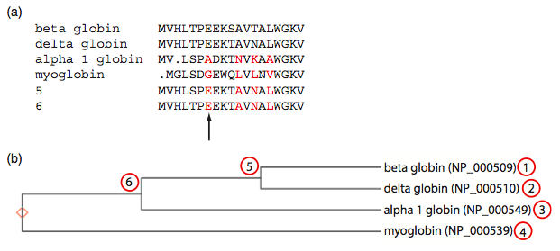
accepted point mutations are defined not by the pairwise alignment but with respect to the common ancestor
Dayhoff et al. applied an evolutionary model to compare changes such as 1 versus 2 not to each other but to an inferred common ancestor at position 5.
B&FG 3e, Fig. 3-7, Page 80

Slide 33
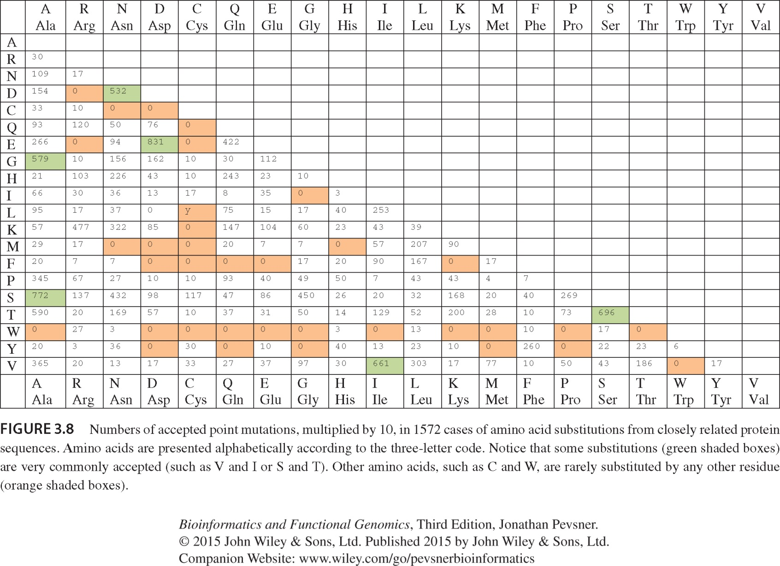
A_{ij} = j replaced by i

Slide 34
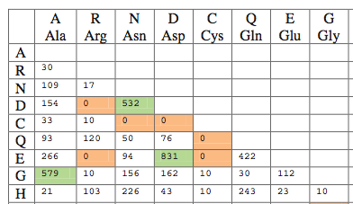
Substitutions are very common (e.g. D → E, A → G) while others are rare (e.g. C → Q, C → E). The scoring system we use for pairwise alignments should reflect these trends.
B&FG 3e, Fig. 3-8, Page 81

Slide 35
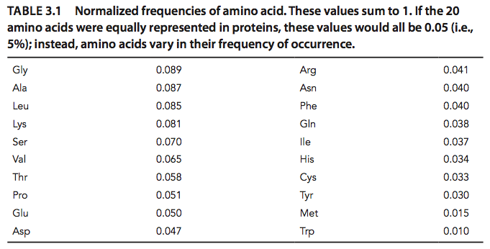
Normalized frequencies of amino acids, f_{i}
some are more common (G, A, L, K) and some rare (C, Y, M, W).
B&FG 3e, Fig. 3-1, Page 81

Slide 36
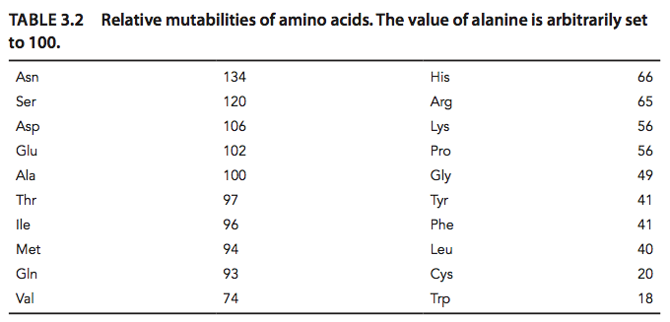
The relative mutability of amino acid j, m_{j}
the # of times j was observed to mutate / the overall occurrence frequency of j (f_{i})
In a scoring system alignment of two tryptophans will be weighted more heavily than two asparagines.
B&FG 3e, Table 3-2, Page 82

Slide 37
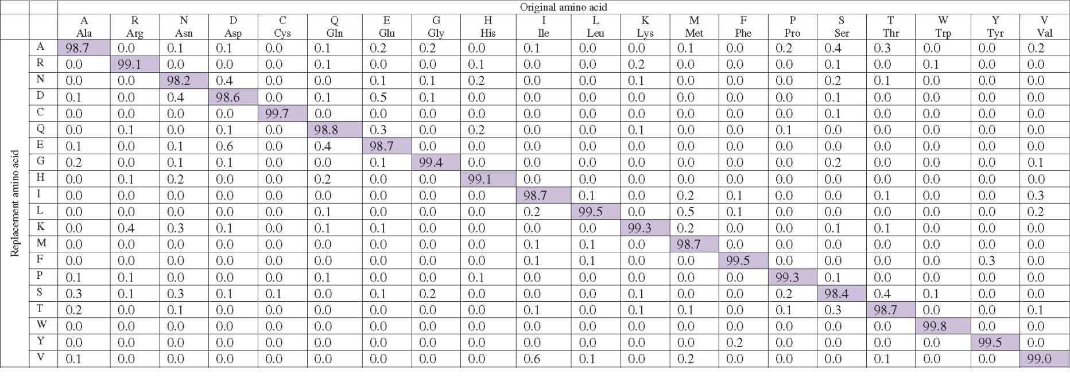
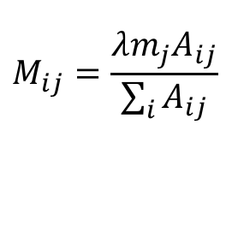
1 PAM - original amino acids (columns) and replacements (rows)
The diagonals: most residues remain the same about 99% of the time (see shaded entries).
cysteine (C) and tryptophan (W) undergo few substitutions, and asparagine (N) many.
The columns are percentages that sum to 100%.
$M_{jj}=1−λm_{j}$, $,\text{where} λ \text{is} \text{a} \text{proportion} \text{constant}$
$$M_{ij}=\frac{λm_{j}A_{ij}}{\sum_{i}{A_{ij}}}$$
B&FG 3e, Fig. 3-9,Page 84

Slide 38
PAM matrices
PAM1
the matrix calculated from comparisons of sequences with no more than 1% divergence.
At an evolutionary interval of PAM1, one change has occurred over a length of 100 amino acids.
Other PAM matrices are extrapolated from PAM1
PAMx = multiplied PAM1 by itself
Adapted from Cedric Notredame

Slide 39
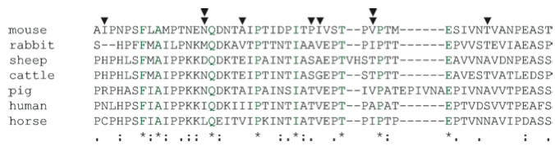
Why PAM250? The alignment of distantly related kappa caseins
There are few conserved column positions, and many some columns (double arrowheads) have five different residues among the 7 proteins.
Design a scoring system that is tolerant of distantly related proteins: if the scoring system is too strict then the divergent sequences may be penalized so heavily that authentic homologs are not identified or aligned.
B&FG 3e, Fig. 3-11, Page 86

Slide 40
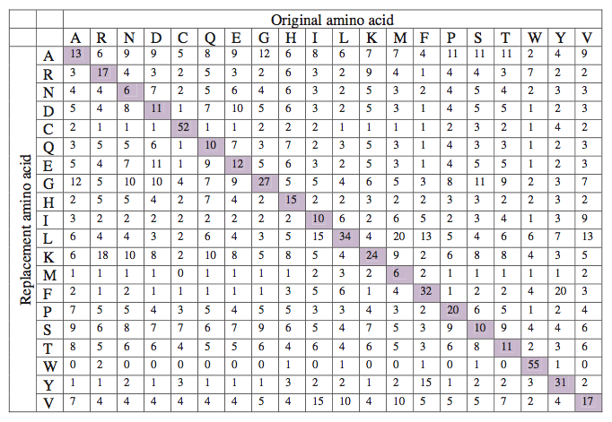
PAM250 matrix: for proteins that share ~20% identity
250 changes have occurred for two proteins over a length of 100 amino acids.
Assumes mutations occur multiple times at any given position
The diagonal still has high scores but much information content is lost.
B&FG 3e Fig. 3-13 Page 88

Slide 41
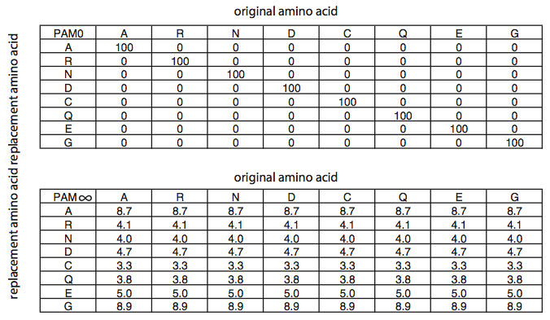
PAM0: at the extreme of perfectly conserved proteins, there are no amino acid replacements. PAM∞: at the extreme of completely diverged proteins, the matrix converges on the background frequencies of the amino acids.
B&FG 3e, Fig. 3-12, Page 86

Slide 42
PAMx = multiplied PAM1 by itself Any similar idea in Discrete mathematics?

Slide 43
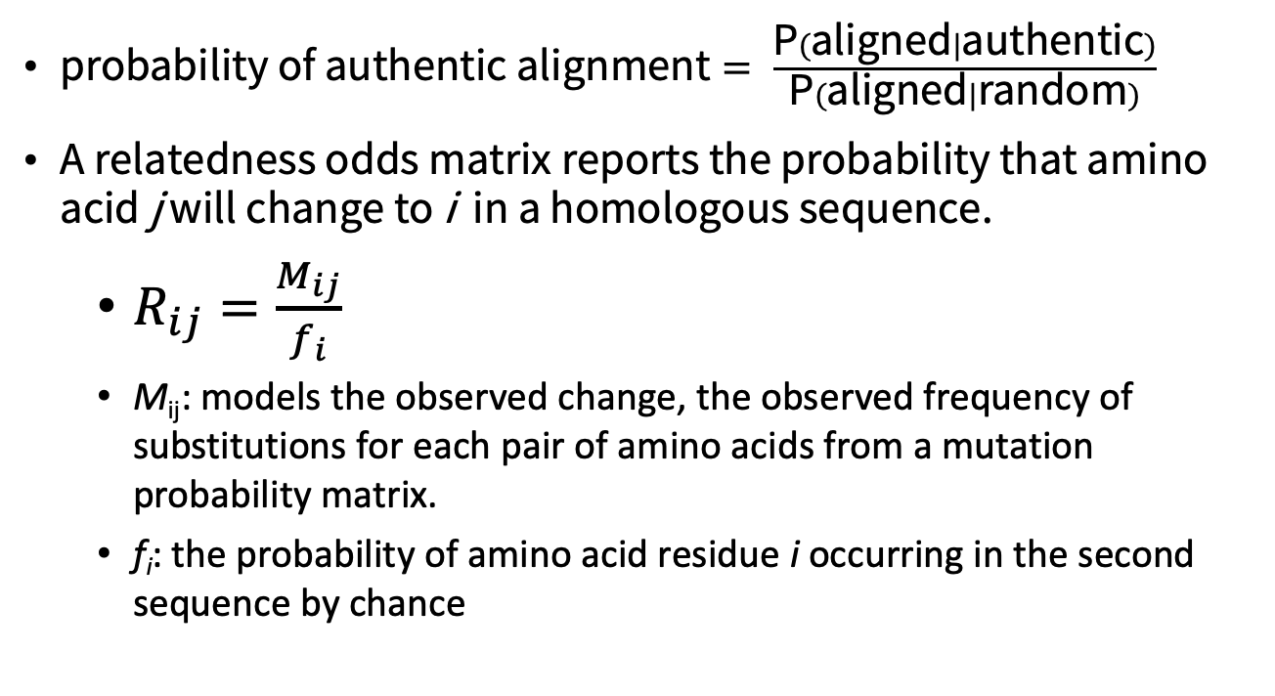
From a mutation probability matrix to a relatedness odds matrix
$\text{probability} \text{of} \text{authentic} \text{alignment}= \frac{\text{P}(\text{aligned}|\text{authentic})}{\text{P}(\text{aligned}|\text{random})}$
A relatedness odds matrix reports the probability that amino acid j will change to i in a homologous sequence.
$R_{ij}=\frac{M_{ij}}{f_{i}}$
M_{ij}: models the observed change, the observed frequency of substitutions for each pair of amino acids from a mutation probability matrix.
f_{i}: the probability of amino acid residue i occurring in the second sequence by chance
B&FG 3e, Eq. 3-3, Page 88

Slide 44
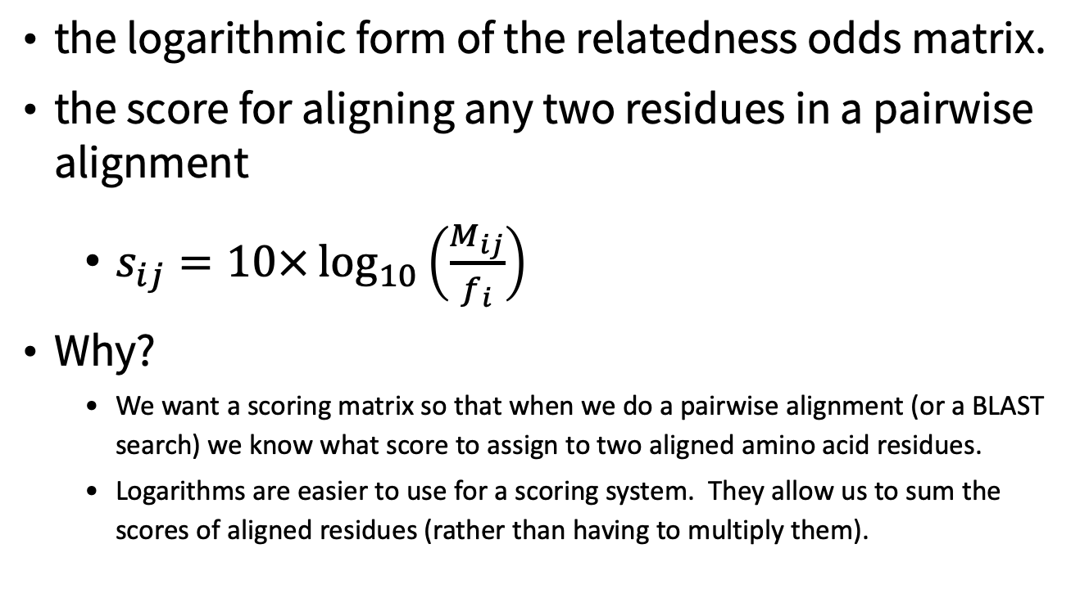
From a mutation probability matrix to a log odds matrix
the logarithmic form of the relatedness odds matrix.
the score for aligning any two residues in a pairwise alignment
$s_{ij}=10×\log_{10}\left(\frac{M_{ij}}{f_{i}}\right)$
Why?
We want a scoring matrix so that when we do a pairwise alignment (or a BLAST search) we know what score to assign to two aligned amino acid residues.
Logarithms are easier to use for a scoring system. They allow us to sum the scores of aligned residues (rather than having to multiply them).
B&FG 3e, Eq. 3-4, Page 89

Slide 45
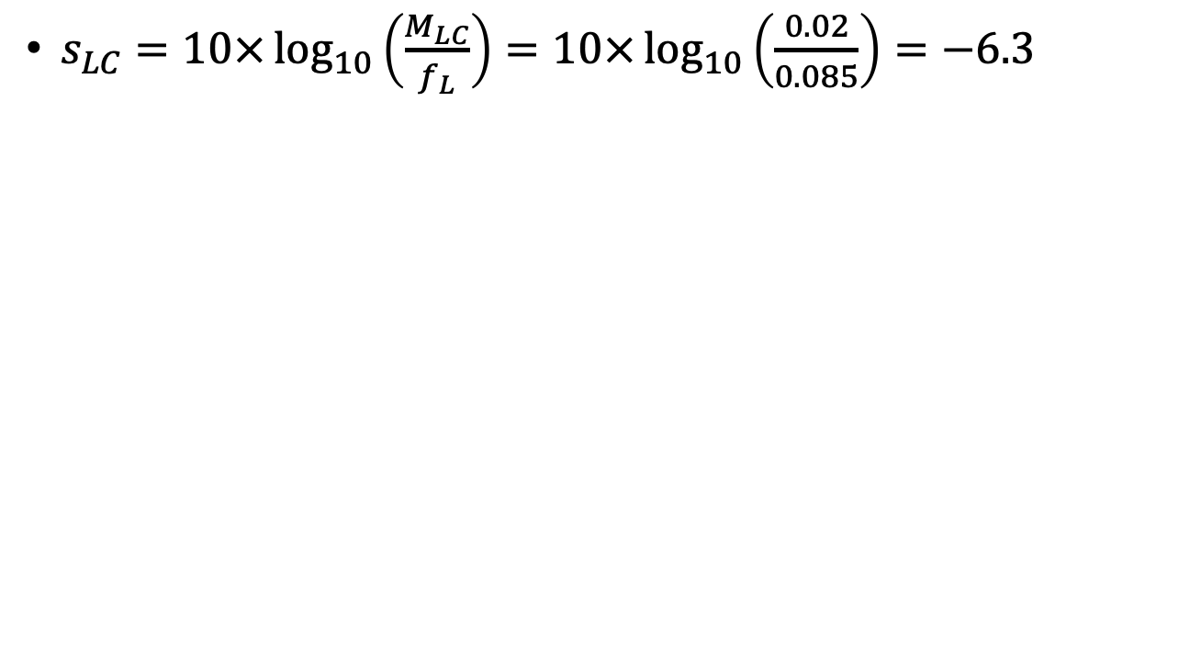
from cysteine (C) to leucine (L) @ PAM250
$s_{LC}=10×\log_{10}\left(\frac{M_{LC}}{f_{L}}\right)=10×\log_{10}\left(\frac{0.02}{0.085}\right)=−6.3$
B&FG 3e, Eq. 3-5, Page 89

Slide 46
What do the numbers mean in a log odds matrix?
0: neutral
+2: indicates that the amino acid replacement occurs 1.6 times as frequently as expected by chance
–10: that the correspondence of two amino acids in an alignment that accurately represents homology (evolutionary descent) is one tenth as frequent as the chance alignment of these amino acids

Slide 47
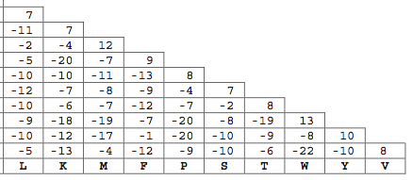
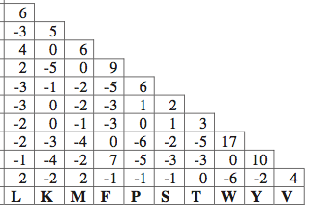
Log-odds matrix for PAM10
Log-odds matrix for PAM250
a scoring matrix with “severe” penalties.
A match of W to W earns +13, but a mismatch (e.g. W aligned to T) has a score of -19, far lower than in PAM250.
a useful matrix for comparing distantly related proteins.
two tryptophan (W) residues earns +17 and a W to T mismatch is -5.
B&FG 3e, Fig. 3-14, Page 90,91

Slide 48
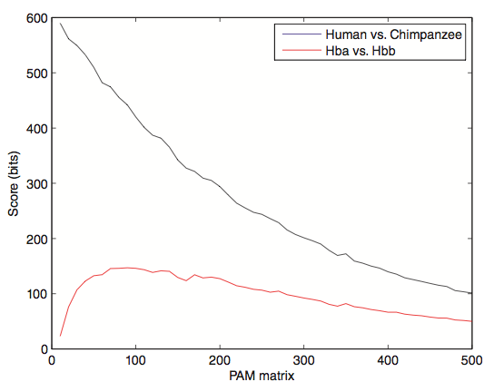
Effect of scoring matrix on bit scores
Look at score for distantly related proteins (e.g. beta globin versus alpha globin) and note that PAM10 or similar matrices assign very low scores. This effect is not seen for very closely related proteins (e.g. a chimp vs. human globin).
B&FG 3e, Fig. 3-16, Page 92

Slide 49
BLOcks SUbstitution Matrix (BLOSUM)
Henikoff, S.; Henikoff, J.G. (1992). "Amino Acid Substitution Matrices from Protein Blocks". PNAS. 89 (22): 10915–10919

Slide 50
Idea of BLOSUM
use aligned ungapped regions of protein families. These are assumed to have a common ancestor.
based on local alignments
Similar ideas but better statistics and modeling. It uses 2000 conserved blocks from 500 families.

Slide 51
Procedure of BLOSUM
Cluster together sequences in a family whenever more than L% identical residues are shared, for BLOSUM-L.
Count number of substitutions across different clusters (in the same family).
Estimate frequencies using the counts.
BLOSUM62 is a matrix calculated from comparisons of sequences with no less than 62% divergence.

Slide 52
BLOSUM Matrices
100
collapse
100
100
collapse
62
62
62
collapse
Percent amino acid identity
30
30
30
BLOSUM80
BLOSUM62
BLOSUM30
Notes:
52

Slide 53
Practice of BLOSUM
BLOSUM62 is the default matrix in BLAST 2.0.
BlOSUM50 and BLOSOM62 are widely used.
Considered the state of the art nowadays.

Slide 54
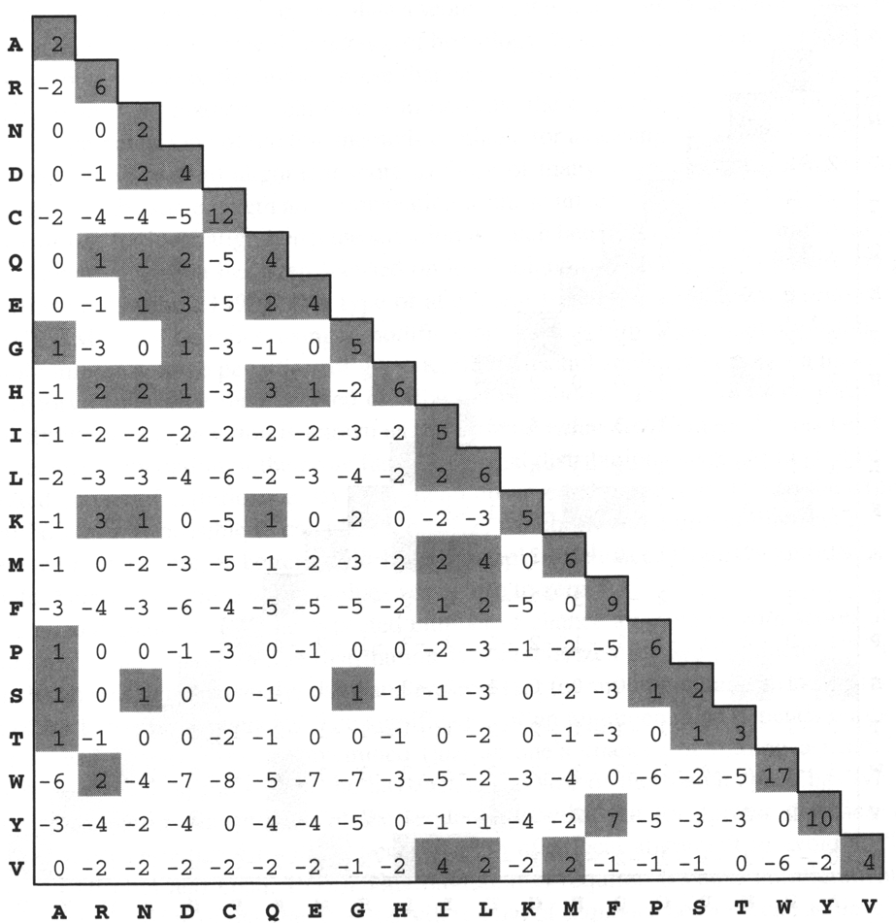
Scoring an Alignment
Most popular Subsitution Matrices
PAM250
Blosum62 (Most widely used)
T P E A
¦ | |
A P G A
Raw Score =
1
+
6
+
0
+
2
= 9
Adapted from Cedric Notredame

Slide 55
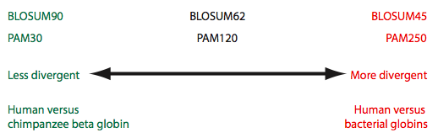
Summary of PAM and BLOSUM matrices
A higher PAM number, and a lower BLOSUM number, tends to correspond to a matrix tuned to more divergent proteins.
B&FG 3e, Fig. 3-18, Page 94

Slide 56
Which Matrix Shall I use?
PAM: Distant Proteins ⬄High Index (PAM 350)
BLOSUM: Distant Proteins ⬄ Low Index (Blosum30)
Choosing The Right Matrix may be Tricky…
GONNET 250> BLOSUM62>PAM 250.
But This will depend on:
The Family.
The Program Used and Its Tuning.
Insertions, Deletions?
Adapted from Cedric Notredame

Slide 57
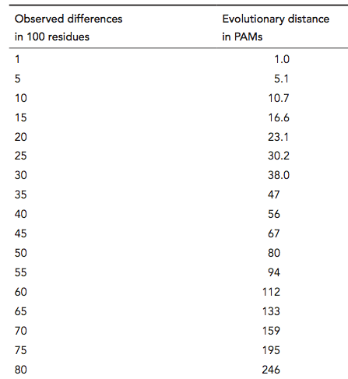
Correspondence between observed differences (per 100 residues) and evolutionary distance (in PAMs)
PAM 80
B&FG 3e
Table 3-3
Page 95
PAM 250

Slide 58
Could I get some idea of when they are likely to do all right?
Adapted from Cedric Notredame

Slide 59


Limits of the substitution Matrices
They ignore non-local interactions
Assume that identical residues are equal
ADKPKRPLSAYMLWLN
They assume evolution rate to be constant.
ADKPKRPLSAYMLWLN
ADKPKRPLSAYMLWLN
Mutations
+
Selection
ADKPRRPLS-YMLWLN
ADKPKRPKPRLSAYMLWLN
Adapted from Cedric Notredame

Slide 60
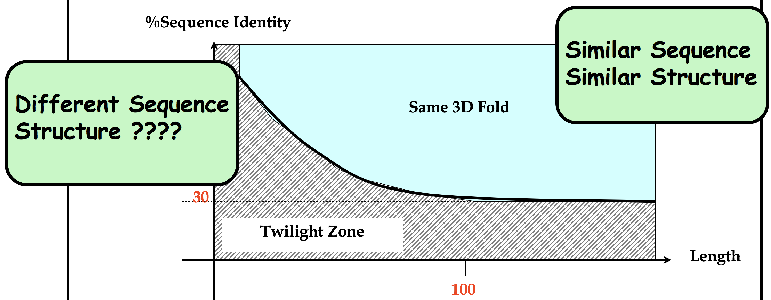
The Twilight Zone
Substitution Matrices Work Reasonably Well on Sequences that have more than 30 % identity over more than 100 residues
Adapted from Cedric Notredame

Slide 61
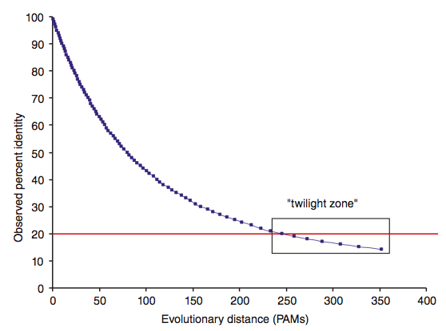
Two randomly diverging protein sequences change in a negatively exponential fashion
B&FG 3e
Fig. 3-19
Page 95

Slide 62
Question: Is it possible to get such a good alignment by chance only?

Slide 63
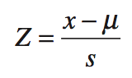
Statistical significance of pairwise alignments
The statistical significance of global alignments is not well described. We can apply a z-score.
For local alignment the statistical significance is thoroughly understood. See BLAST.
B&FG 3e
Fig. 3-26
Page 106

Slide 64
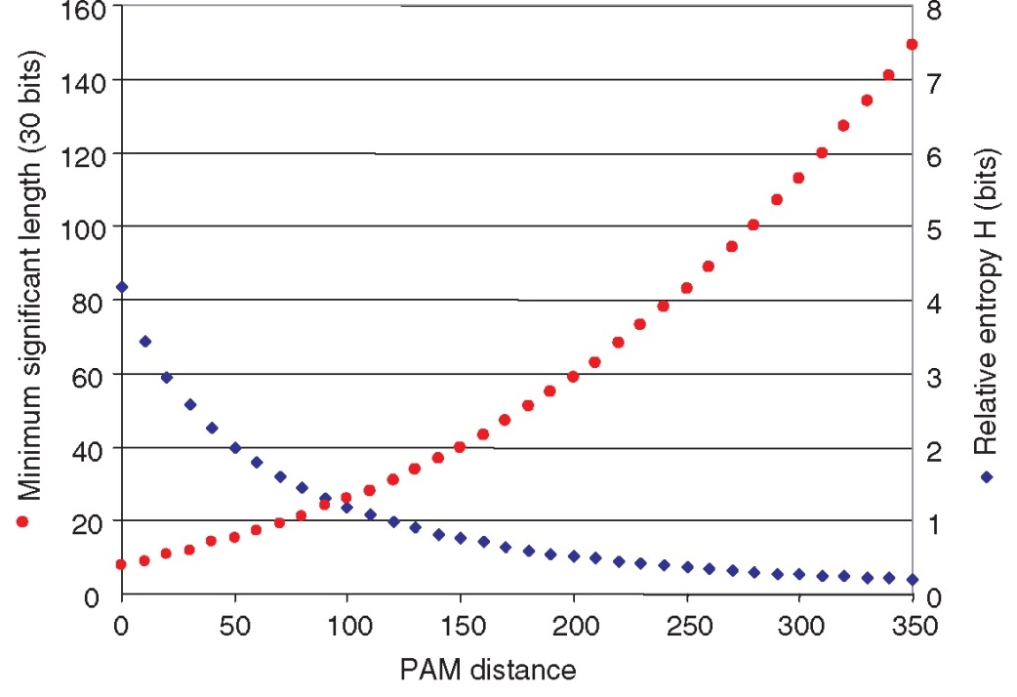
Relative entropy (H, the information content in bits) as a function of PAM distance
PAM matrices with low values (e.g. PAM10), H is high
the minimum alignment length needed to detect a significant pairwise alignment => short.
PAM250, H is low
a longer region of amino acids aligned (e.g. 80 residues) to detect significant pairwise relatedness.
B&FG 3e
Fig. 3-27
Page 109

Slide 65
Pairwise Alignment

Slide 66
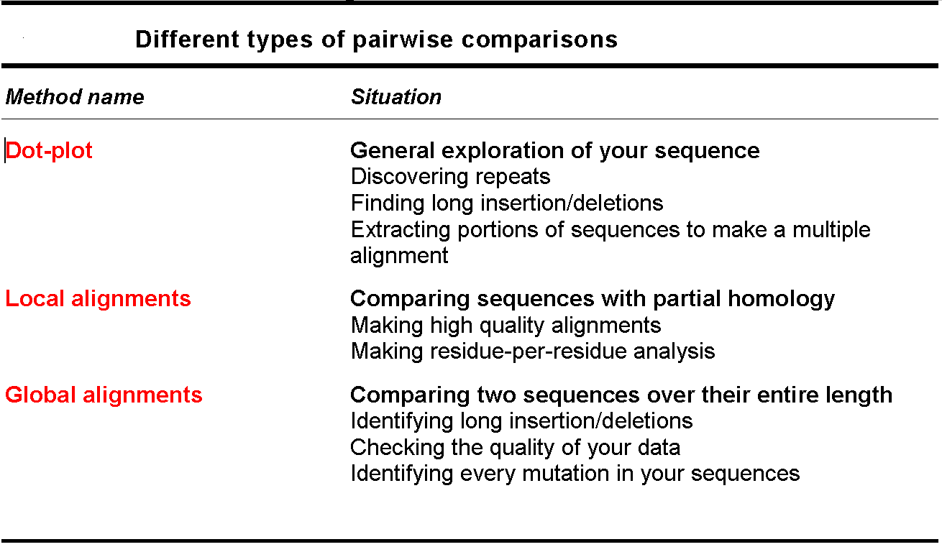
HOW Can we Align Two Sequences?
Adapted from Cedric Notredame

Slide 67
Dot Matrices
What are the elements shared by two sequences ?
>Seq1
THEFATCAT
>Seq2
THELASTCAT
T
H
E
F
A
T
C
A
T
T
H
E
F
Window
A
S
T
C
Stringency
A
T
Adapted from Cedric Notredame

Slide 68
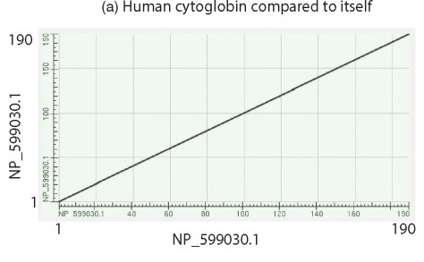
Pairwise alignment with dotplots
A human globin searched against itself produces a unit diagonal on a dot plot (NCBI BLASTP, aligning 2 sequences).
B&FG 3e
Fig. 3-25
Page 105

Slide 69
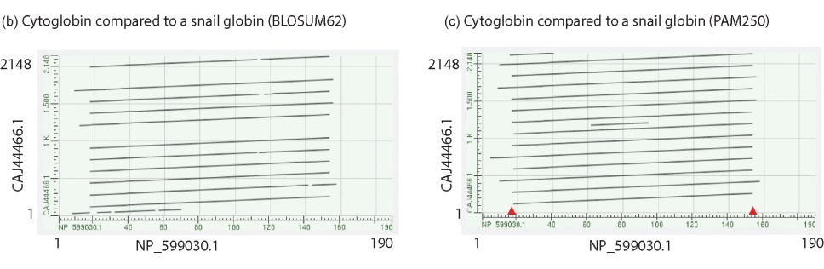
Pairwise alignment with dotplots
Search human cytoglobin against a large snail globin (having many globin repeats). More repeats are observed using PAM250 than BLOSUM62.
To “read” this plot note that cytoglobin (x-axis) matches the snail globin (y-axis) at about a dozen locations across the snail protein. Red arrows indicate that the first few and last few amino acids of cytoglobin do not participate in this repeat structure.
B&FG 3e, Fig. 3-25Page 105

Slide 70
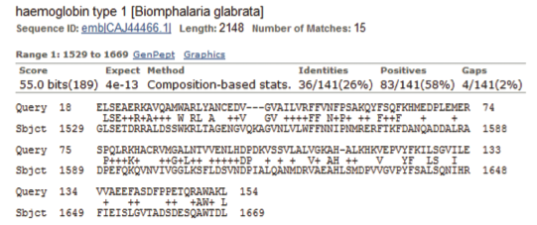
Pairwise alignment with dotplots
BLASTP output includes the various sequence alignments. One is shown here: human cytoglobin (residues 18-154) aligns to the snail globin (at residues 1529-1669). The expect value is convincing (4e-13), and this is one of a dozen sequence alignments.
Conclusion: the dotplot is an excellent way to visualize complex repeats.
B&FG 3e
Fig. 3-25
Page 105

Slide 71
Dot Matrices - limits
Visual aid
Best Way to EXPLORE the Sequence Organisation
Does NOT provide us with an ALIGNMENT
wheat --DPNKPKRAMTSFVFFMSEFRSEFKQKHSKLKSIVEMVKAAGER
| | |||||||| || | ||| ||| | |||| ||||
????? KKDSNAPKRAMTSFMFFSSDFRS----KHSDL-SIVEMSKAAGAA
Adapted from Cedric Notredame

Slide 72
Global Alignments
Take 2 Nice Protein Sequences
A good Substitution Matrix (blosum)
DYNAMIC PROGRAMMING
>Seq1
THEFATCAT
>Seq2
THEFASTCAT
THEFA-TCAT
THEFASTCAT
DYNAMIC
PROGRAMMING
Adapted from Cedric Notredame

Slide 73
Using Dynamic Programming To Align Sequences
Understanding the DP concept
Coding a Global and a Local Algorithm
Aligning with affine gap penalties
Adapted from Cedric Notredame

Slide 74
Dynamic Programming

Slide 75
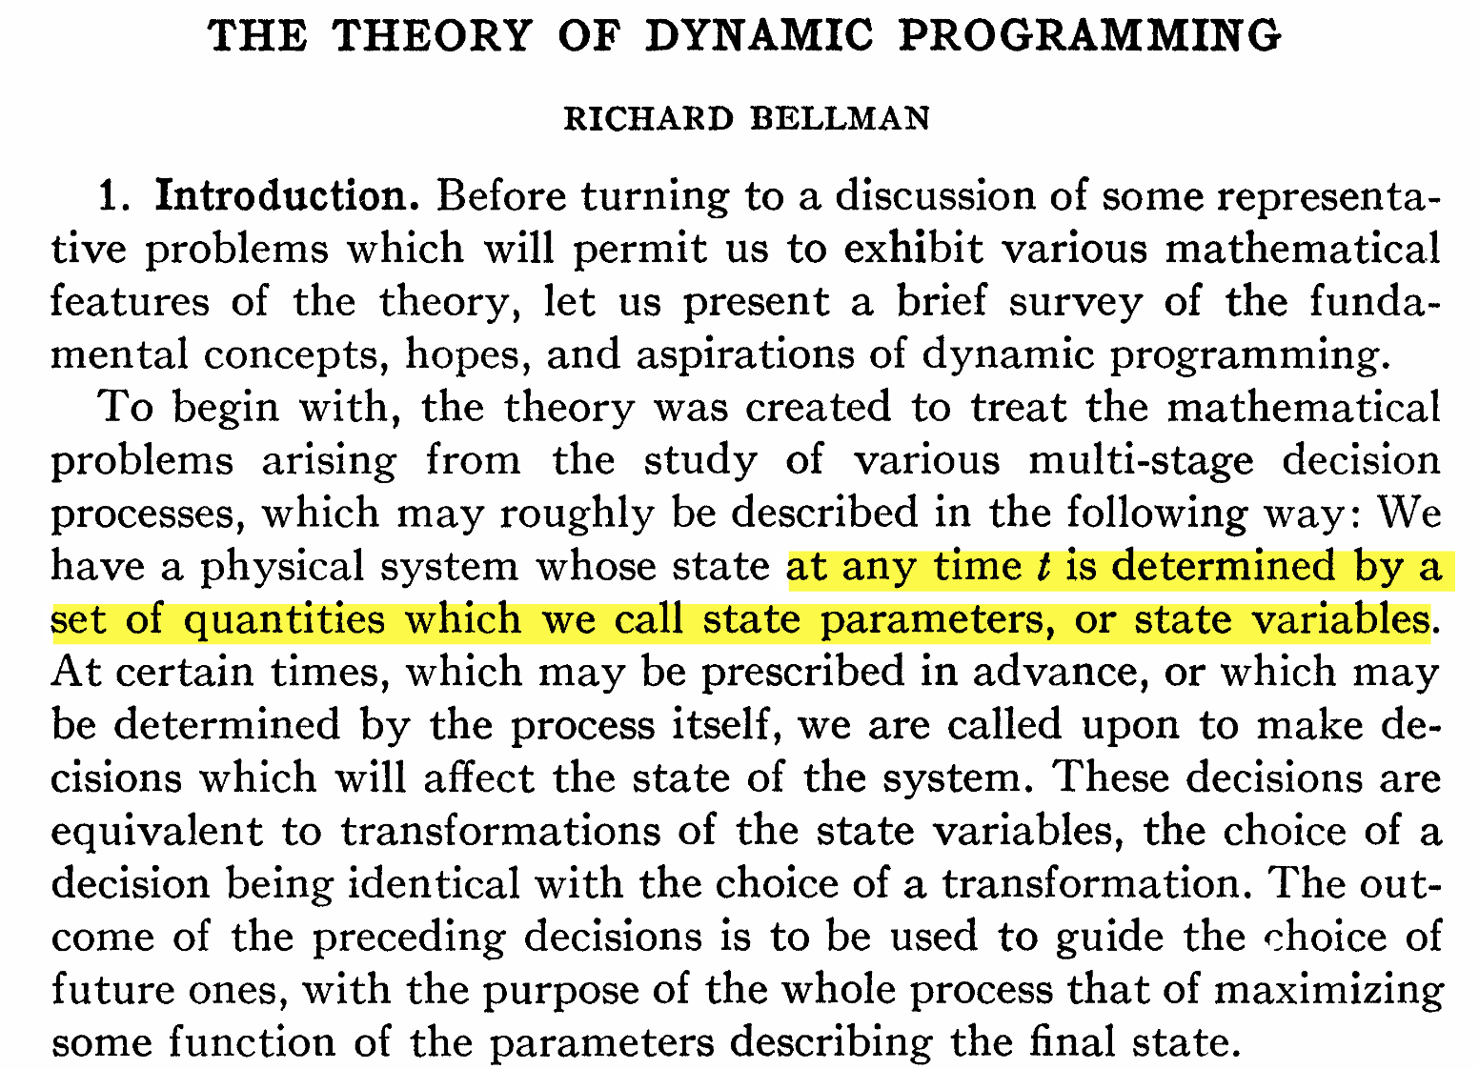
Bellman, R. The theory of dynamic programming. Bulletin of the American Mathematical Society 60, 503–515 (1954).

Slide 76
Using Dynamic Programming To Align Sequences
DP invented in the 1950s by Bellman
Programming ⬄ Tabulation
Re-invented in 1970 by Needlman and Wunsch
It took 10 year to find out…
Needleman, Saul B. & Wunsch, Christian D. (1970). "A general method applicable to the search for similarities in the amino acid sequence of two proteins". Journal of Molecular Biology. 48 (3): 443–53
Adapted from Cedric Notredame

Slide 77
Global Alignment
Needleman, Saul B. & Wunsch, Christian D. (1970). "A general method applicable to the search for similarities in the amino acid sequence of two proteins". Journal of Molecular Biology. 48 (3): 443–53

Slide 78
The Foolish Assumption
The score of each column of the alignment is independent from the rest of the alignment
It is possible to model the relationship between two sequences with:
A substitution matrix
A simple gap penalty
Adapted from Cedric Notredame

Slide 79
The Principal of DP
If you extend optimally an optimal alignment of two sub-sequences, the result remains an optimal alignment
X
-
Deletion
X-XX
XXXX
+
?
?
X
X
Alignment
-
X
Insertion
Adapted from Cedric Notredame

Slide 80
Finding the score of i,j
Sequence 1: [1-i]
Sequence 2: [1-j]
The optimal alignment of [1-i] vs [1-j] can finish in three different manners:
-
X
X
X
X
-
Adapted from Cedric Notredame

Slide 81
Finding the score of i,j
1…i
1…j-1
+
-
j
Three ways to build the alignment
1…i-1
1…j-1
i
j
1…i
1…j
+
1…i-1
1…j
+
i
-
Adapted from Cedric Notredame

Slide 82
Formalizing the algorithm
score_m(i,j-1) + gap_s
1…i
1…j-1
+
-
X
score_m(i,j)= best
score_m(i-1,j-1) +
match_s/mismatch_s
1…i-1
1…j-1
+
X
X
score_m(i-1,j) + gap_s
1…i-1
1…j
+
X
-
Adapted from Cedric Notredame

Slide 83
Arranging Everything in a Table
-
F
A
T
-
F
1…I-1
1…J-1
1…I
1…J-1
A
1…I-1
1…J
1…I
1…J
S
T
Adapted from Cedric Notredame

Slide 84
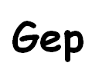
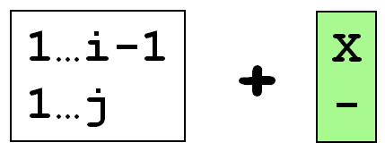
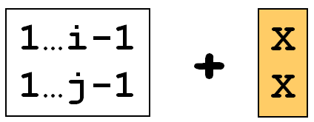
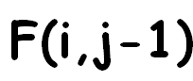
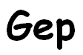
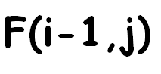
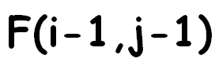
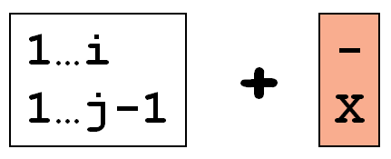


Filing Up The Matrix
1…i
1…j-1
+
-
X
score_m(i,j-1) + gap_s
score_m(i,j)= best
score_m(i-1,j-1) +
match_s/mismatch_s
1…i-1
1…j-1
+
X
X
score_m(i-1,j) + gap_s
1…i-1
1…j
+
X
-
Adapted from Cedric Notredame

Slide 85
-
F
A
T
-
-1
-2
-3
0
F
-1
+2
-2
-2
-3
-3
-4
-2
+2
+1
+1
0
0
A
-2
+1
-2
+4
0
-1
+1
+4
0
-3
0
+3
+3
S
-3
0
-3
0
+3
+2
0
+3
+3
-4
-1
+2
+3
T
-4
-1
+2
-4
-1
+5
+2
-5
-1
-2
+2
+5
+1
Adapted from Cedric Notredame

Slide 86

Delivering the alignment: Trace-back
T
T
S
-
A
A
F
F
Score of 1…3 Vs 1…4
⬄
Optimal Aln Score
Adapted from Cedric Notredame

Slide 87
Trace-back: possible implementation
while (!(i==0 && j==0)):
if (direc_m[i][j]== ‘sub’): #SUBSTITUTION
aln1[aln_len]=pro1Seq[--i] aln2[aln_len]=pro2Seq[--j]
elif (direc_m[i][j]==‘del’): #DELETION
aln1[aln_len]='-'
aln2[aln_len]=pro2Seq[--j]
elif (direc_m[i][j]==‘ins’): #INSERTION
aln1[aln_len]=pro1Seq[0][--i]
aln2[aln_len]='-'
aln_len++
}
Adapted from Cedric Notredame

Slide 88
Installing R
CRAN http://cran.r-project.org
the central repository for the most popular R libraries & serves the central role for R
R https://www.r-project.org/
Git https://git-scm.com/downloads
RStudio https://www.rstudio.com/products/rstudio/download/

Slide 89
Try the help command
Start R or RStudio and type help(ls) to get
documentation on the ls command used in our example.

Slide 90
Starting with R
How to use package?
install.package(’ctv’)
library(‘ctv’)
How many packages?
https://cran.r-project.org/web/views/

Slide 91
sessionInfo()
what packages are present in your session
Very information for reproducing your analysis => keep essential information when writing paper

Slide 92
References
CRICK, F. H. On protein synthesis. Symp. Soc. Exp. Biol. 12,138–63 (1958).
Bellman, R. The theory of dynamic programming. Bulletin of the American Mathematical Society 60, 503–515 (1954).
Needleman, S. B. & Wunsch, C. D. A general method applicable to the search for similarities in the amino acid sequence of two proteins. J. Mol. Biol. 48, 443–53 (1970).
Smith, T. F. & Waterman, M. S. Identification of common molecular subsequences. J. Mol. Biol. 147, 195–7 (1981).

Slide 93

http://changlabtw.com
chang.jiaming@gmail.com
Thank You Any Question?

